Slide 1
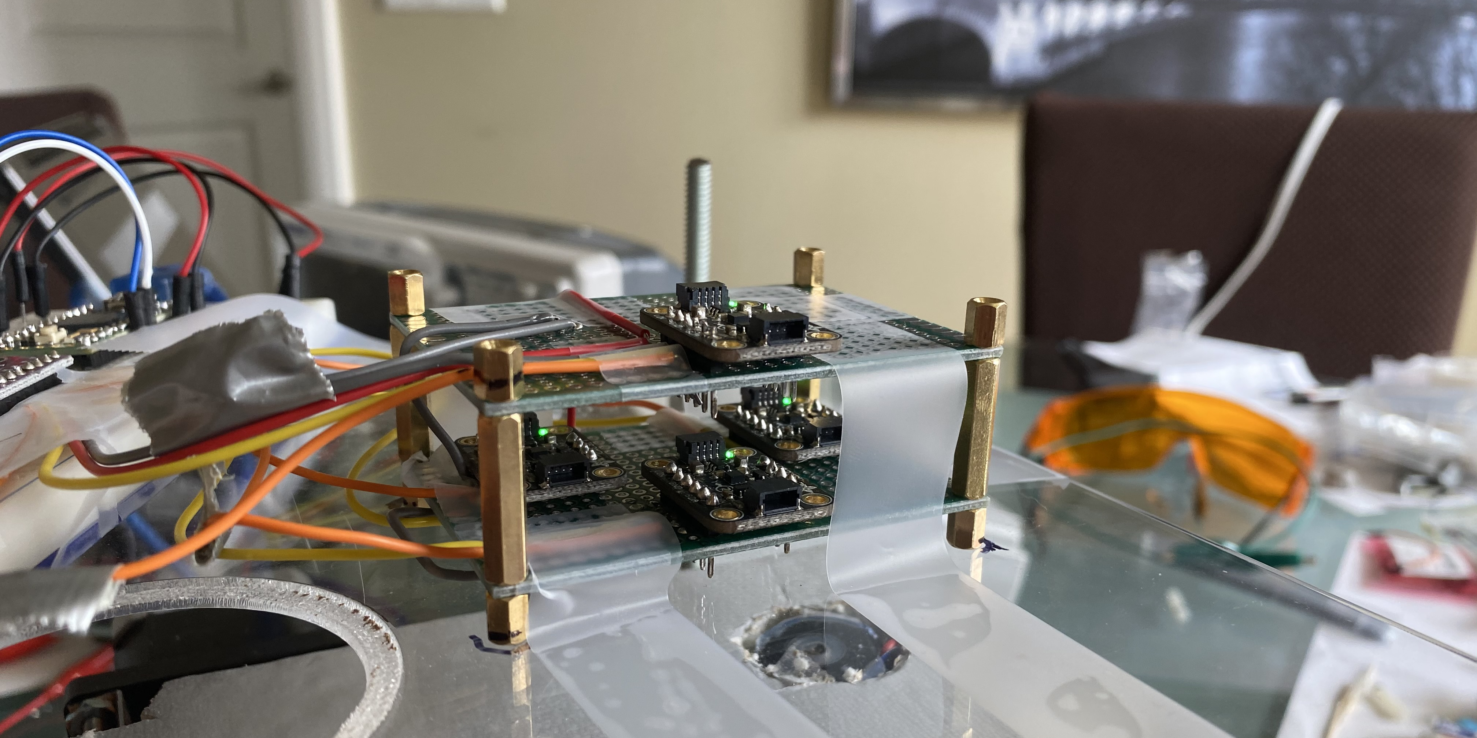
CSE 490V VIRTUAL REALITY SYSTEMS
Finger Tracking using Magnetometers
Alexander Mastrangelo and Paul Yoo

Slide 2
MOTIVATION
Want high quality finger tracking
Want to avoid cameras

Slide 3
OVERVIEW
Position Tracking using Magnetometers

Slide 4
RELATED WORK

Slide 5
TOPIC 1
Alternatives to magnetic tracking:
Camera based tracking
Lighthouse
Very precise IMU

Slide 6
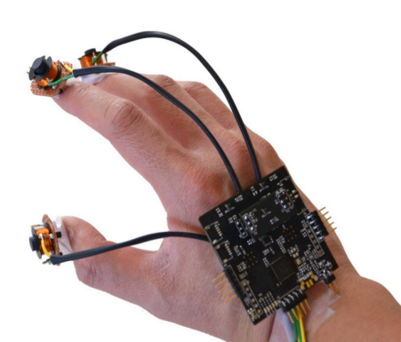
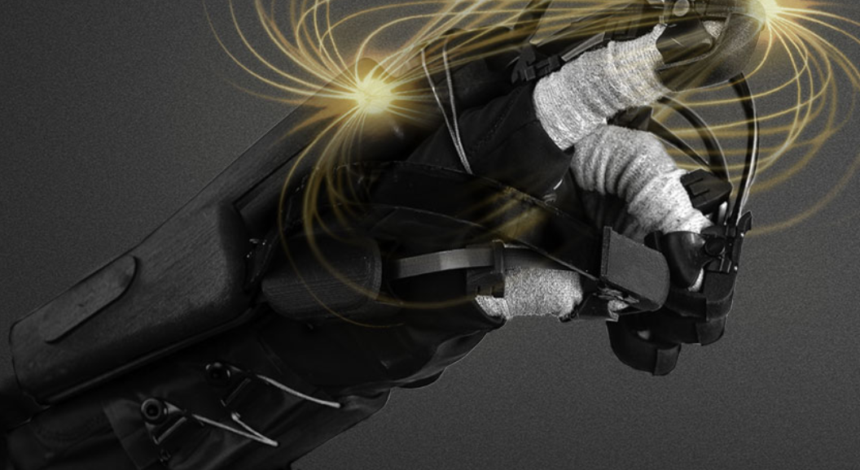
TOPIC 2
Previous Work:
Finexus tracking system
HaptX glove

Slide 7
TOPIC 3
Key related work should be explained in this section. The emphasis should be on comparing and contrasting the approaches taken to your problem in the past. Try to provide some taxonomy to think about prior methods (e.g., major categories). Also try to point out the known benefits and limitations of prior methods. Your goal is to be thorough and honest in this section. You don’t want an audience member to point out a key piece of related work that you missed or misrepresented. Your goal is to show that you’re done a thorough literature search and, based on that, you think your approach is novel. (If your approach isn’t novel for this final project, that’s okay; but, you’ll want to explain what prior work you’re implementing clearly and why you selected it over alternatives.

Slide 8
METHOD

Slide 9
EXPLAINATION OF THEORY/CONCEPT
This section should explain the theory behind your approach. It should emphasize the underlying mathematics, image formation models, or other fundamental concepts. If you are describing an application, then your “method” and “implementation” sections may be combined into a single section. The goal is to convey all the core concepts needed to solve the problem, not the specific hardware and software used in your solution. If you’re going to have equations in your talk, then this is the section to put them in.

Slide 10
IMPLEMENTATION DETAILS

Slide 11
HARDWARE AND SOFTWARE DISCUSSION
In this section you can go into the specific hardware and software you used. If you built something, then show photographs and videos of how it was constructed. Again, full slide visuals are much better than lots of text and bullet points. You should include screenshots and video clips of your demo. Consider using your mobile phone to record a video of someone using your system. Your goal is to let the audience feel like they have tried the demo and understand what the results would be like in person. The secondary goal is to make sure you’ve documented the work well enough to share it in the future, long after the specific demo hardware and software are no longer available or working.

Slide 12
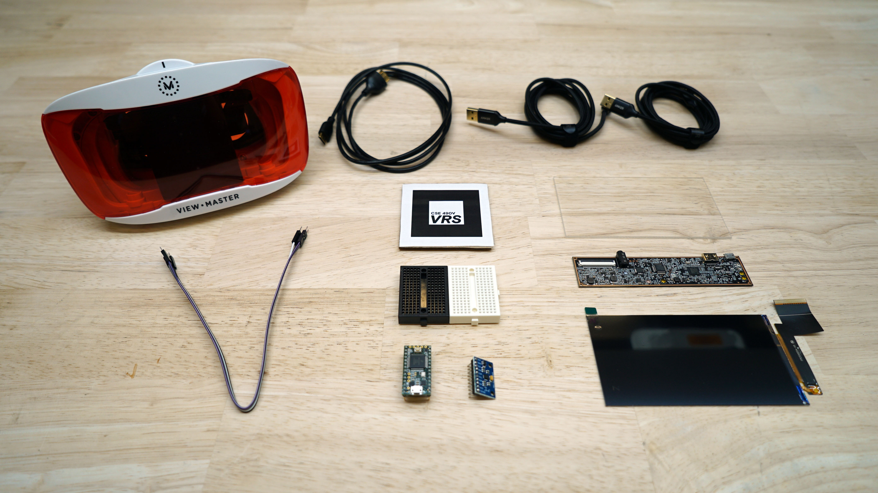
HARDWARE PHOTOS AND VIDEOS

Slide 13
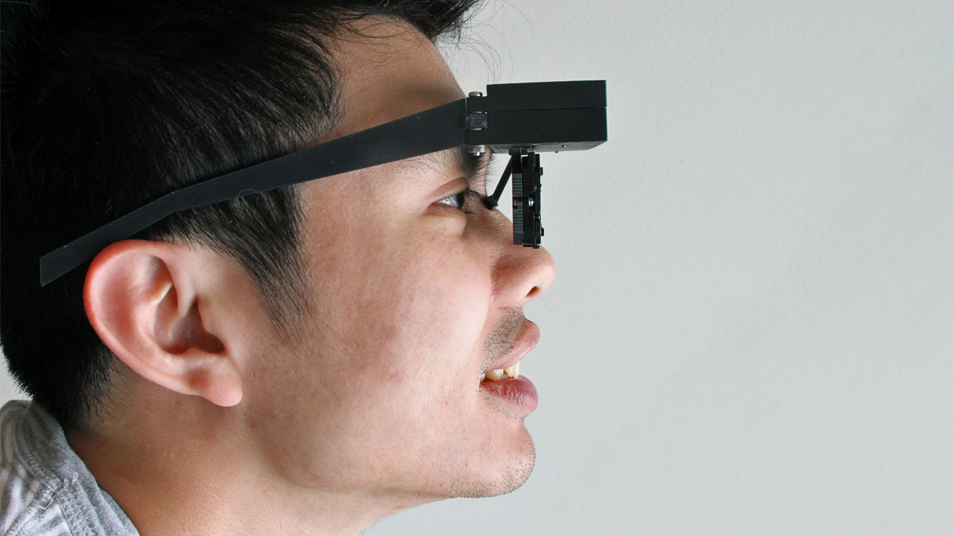
HARDWARE PHOTOS AND VIDEOS
Lanman and Luebke. 2013. Near-Eye Light Field Displays. ACM SIGGRAPH Asia.

Slide 14
EVALUATION OF RESULTS

Slide 15
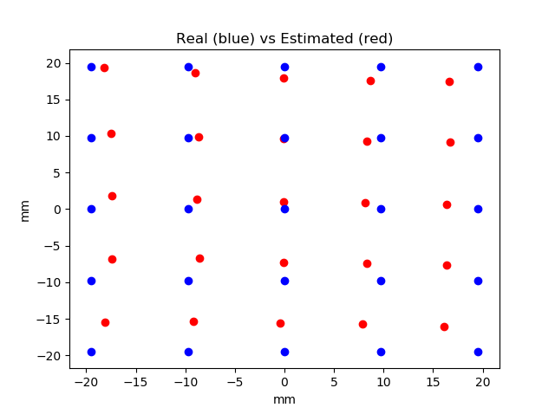
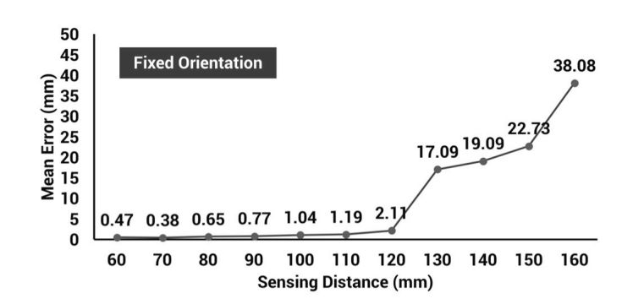
QUANTITATIVE PERFORMANCE VS. PRIOR WORK
Mean error distance:1.23 mm Std of error distance: 2.60 mm
Similar in accuracy to Finexus tracker?
Conclusion: Not Really
Source: Oculus Finexus Paper

Slide 16
DISCUSSION

Slide 17
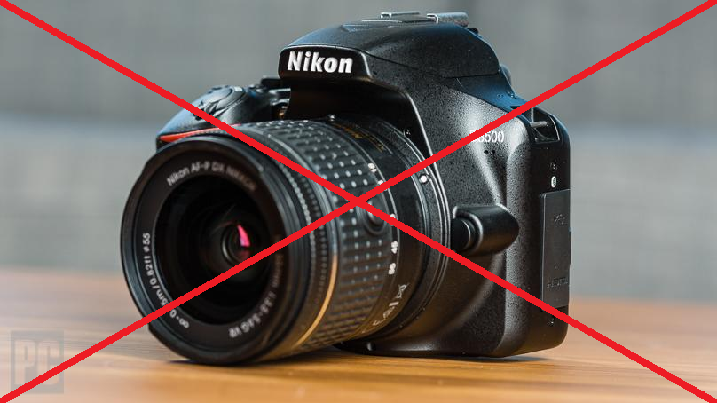
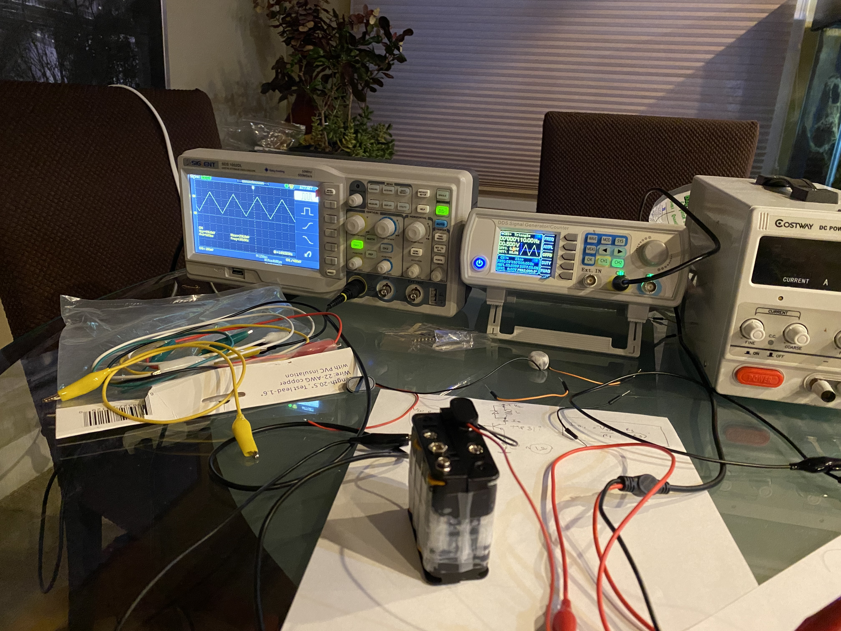
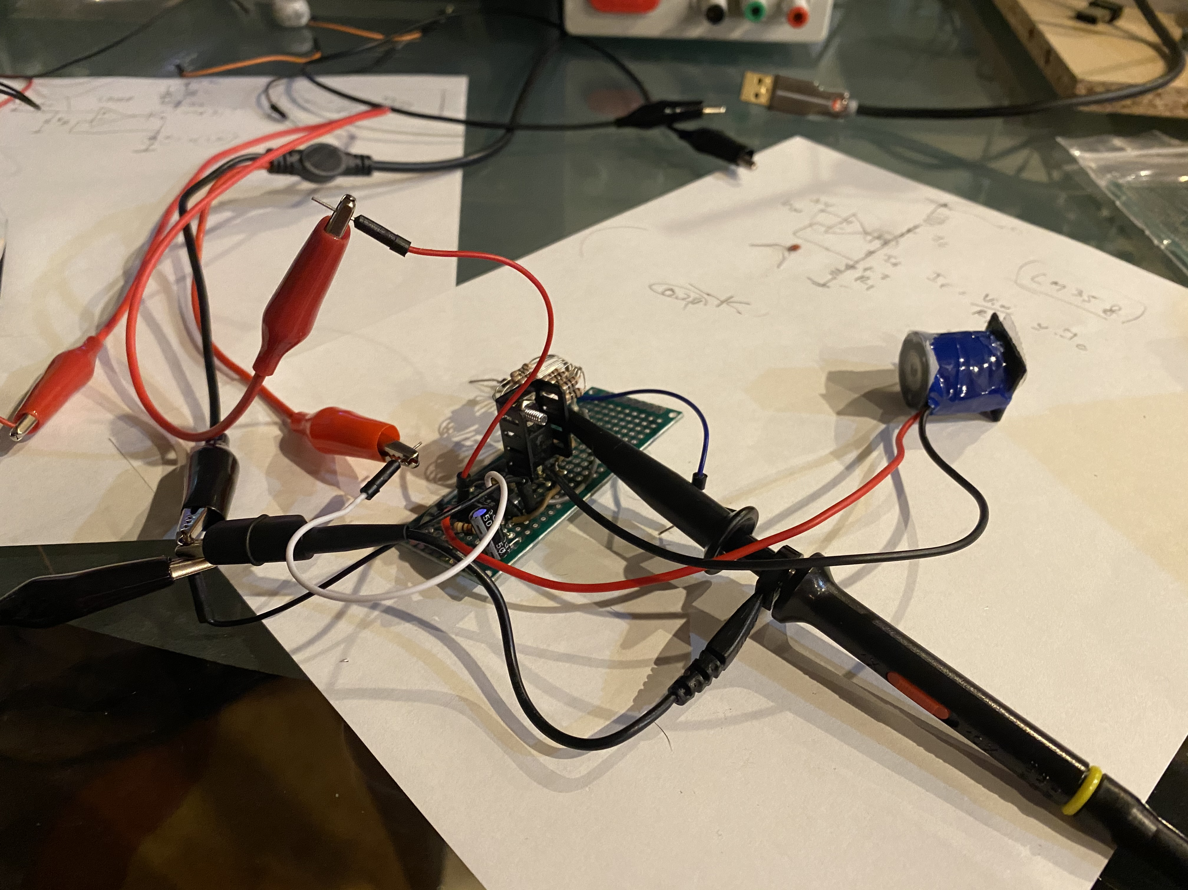
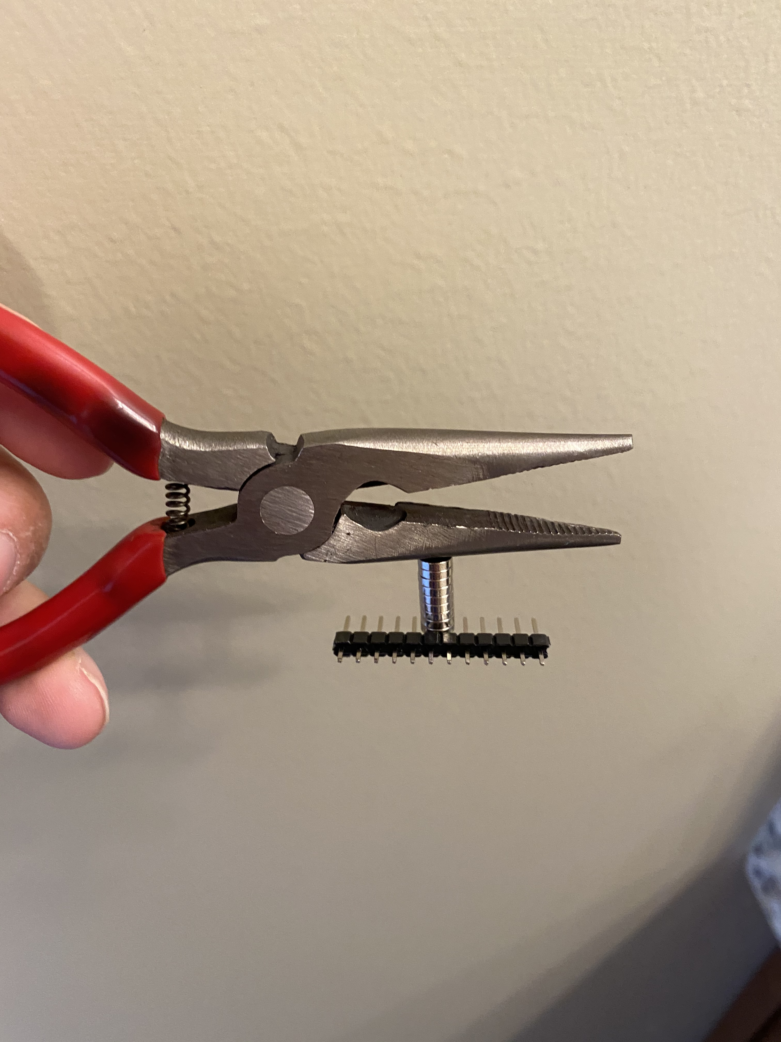
BENEFITS AND LIMITATIONS
Benefits:
No camera/lighthouse required
Doesn’t suffer from occlusion problems
Can be scaled easily to track arbitrary # of magnets
Limitations:
Affected by nearby magnetic material
Requires power and extra circuitry to drive magnets
Interferes with IMU magnetometer

Slide 18
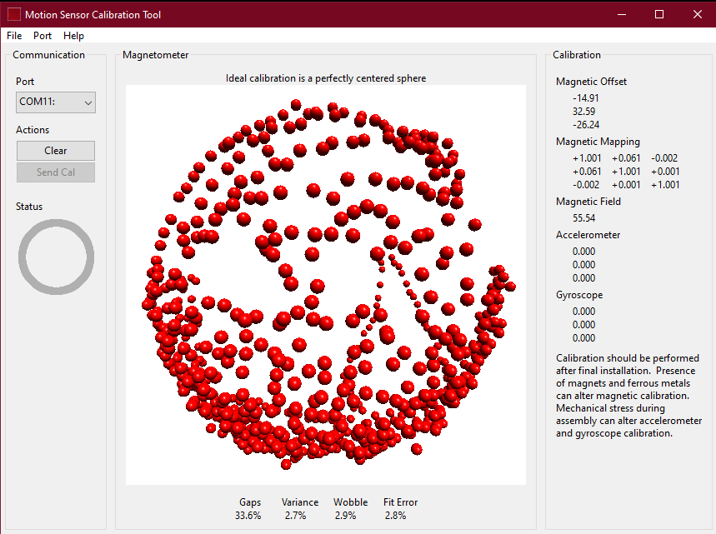

FAILURE CASES
Requires constant re-calibration
High frequency movement

Slide 19
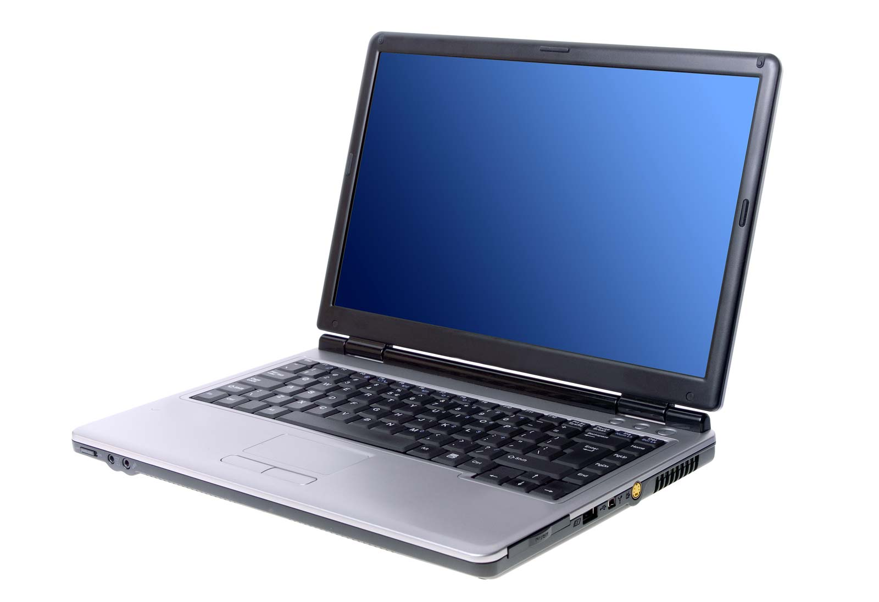
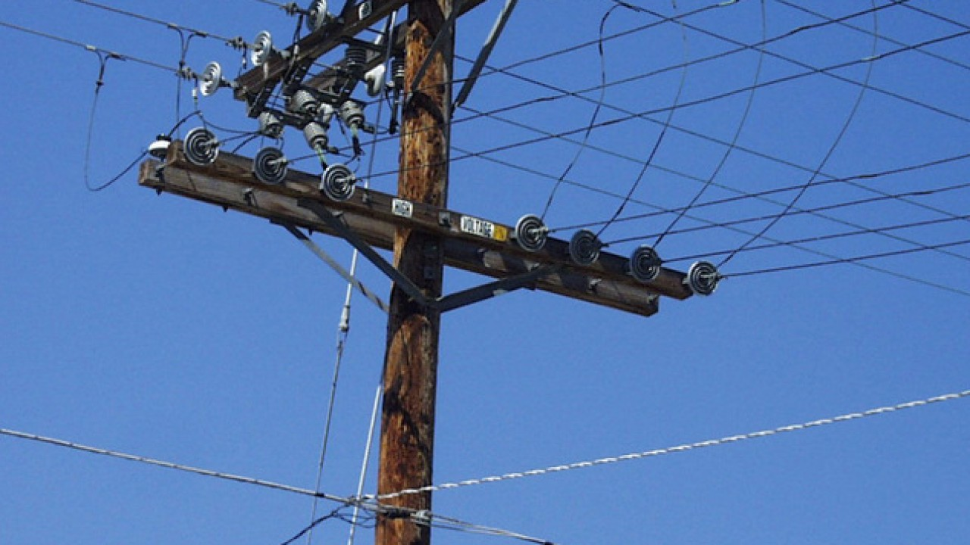
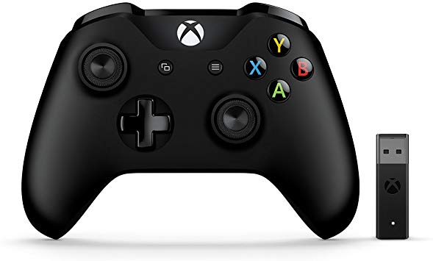
FAILURE CASES
Electrical Noise

Slide 20
CONCLUSION

Slide 21
SUMMARY OF CONTRIBUTIONS
You can end your talk by repeating your motivation/overview materials. Now everyone understands what you claimed at the beginning. Remind the audience why this problem matters, what you did, and what you learned as a result.

Slide 22
APPENDIX

Slide 23
ADDITIONAL RESULTS
Make sure to include additional results, if you expect the audience to ask about certain things you didn’t have time to cover.

Slide 24
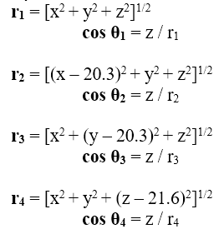
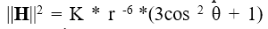
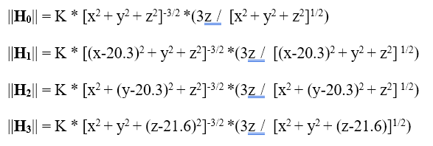
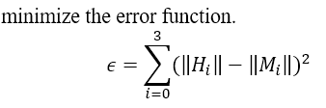
MATHEMATICAL DERIVATIONS

